Slide 2
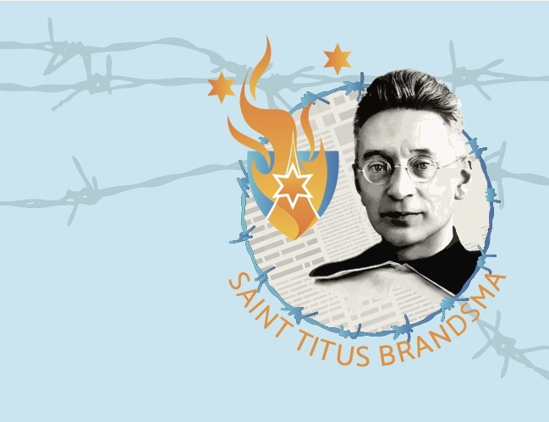
Saint Titus Brandsma has a profound message for us today on encountering the “mystery of God’s nearness”. From his life as a young Carmelite friar to his martyrdom in Dachau, we can learn how living fully in the present moment, mindful that we are always in God’s holy presence, is closely connected to the ordinary life of ordinary people. In our daily life, with its busyness, challenges and struggles, experiencing God’s nearness might seem too far away or out of reach. The mystery of God’s nearness, this everyday mysticism that we learn from Titus, will be the focus of our conversation.

Slide 3
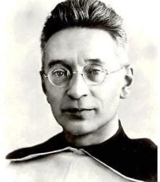
Brandsma was beatified by Pope John Paul II in November 1985 as a martyr of the faith
and canonized as a saint on 15 May 2022 by Pope Francis.
His feastday is July 27

Slide 4
Titus Brandsma, a mystic and martyr, shows us the value of living love, and prayer. He offers us today his spiritual wisdom and hope.
A man at home with God and in the world, this Dutch Carmelite was born in Friesland in 1881. As professor at the University of Nijmegen he was involved in Catholic life when the Netherlands was invaded in 1941. Actively promoting freedom of speech, the Nazis considered him ‘a dangerous little friar’. Consequently he met his death at Dachau in 1942.
The spiritual wisdom of Titus Brandsma shows us how to “trust God in circumstances we do not understand” and to “ see God in the work of His hands and the marks of His love in every visible thing then we too can be bearers of this love for every human being.”

Slide 5
His parents, who ran a small dairy farm, were devout and committed Catholics, a minority in a predominantly-Calvinist region, in the Province of Friesland
Family home in Oegeklooster,
near Hartwerd
Titus Brandsma (died 1920)
Tjitsje Postma (died 1933)

Slide 6
With the exception of one daughter, all of their children (three daughters and two sons) entered religious orders.

Slide 7
Titus Brandsma entered the novitiate of the Carmelite friars in Boxmeer on 17 September 1898, at 17yo, (Feastday of St Albert of Jerusalem, Rule-giver) where he took the religious name Titus (in honor of his father). He professed his first vows in October 1899.
A very young Titus in formation
Titus with his second cousin

Slide 8
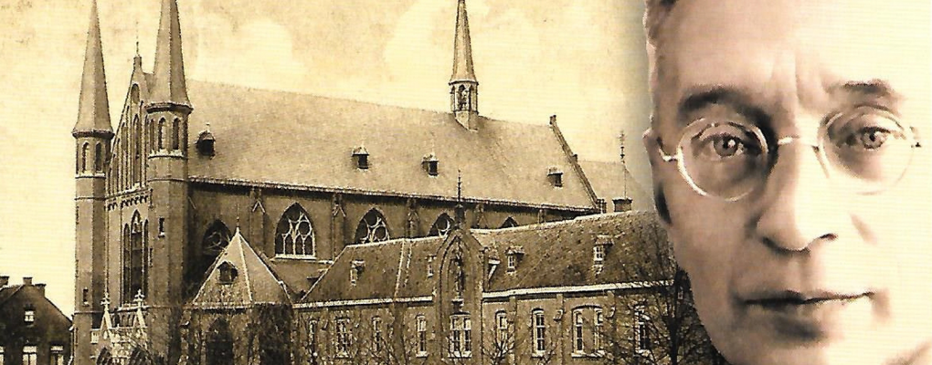
His Carmelite vocation
He entered the Carmelites in 1898 in Boxmeer at 17 yo.
Rather than pursue his studies with the Franciscans, Brandsma entered the Carmelites because he had a strong interest in Carmelite spirituality
He felt powerfully drawn to the mystical side of the life of faith through the influence of his second cousin a young Carmelite Casimir de Boer
Right from the beginning of his Carmelite life he felt a strong interest in the communal life believing that the liberating and creative word of God comes to him via a community just as it did in the years of his childhood when he received the words from his parents.

Slide 9
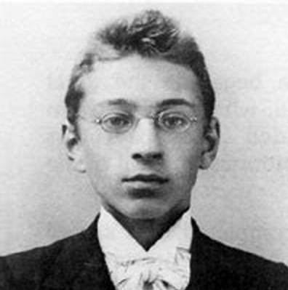
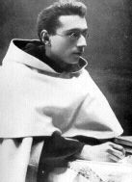

Slide 10
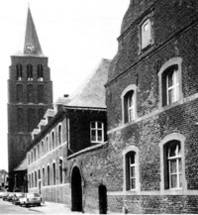
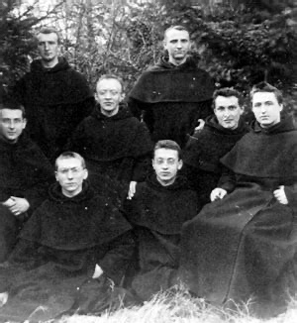
Monastery and Church - BOXMEER
Titus with other Carmelite Students

Slide 11
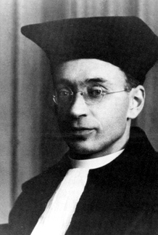
Scholar & Teacher
Ordained a priest in 1905, Brandsma was knowledgeable in Carmelite mysticism and was awarded a doctorate of philosophy at Rome in 1909. He then taught in various schools in the Netherlands. From 1916 on, he initiated and led a project to translate the works of St. Teresa of Ávila into Dutch.

Slide 12
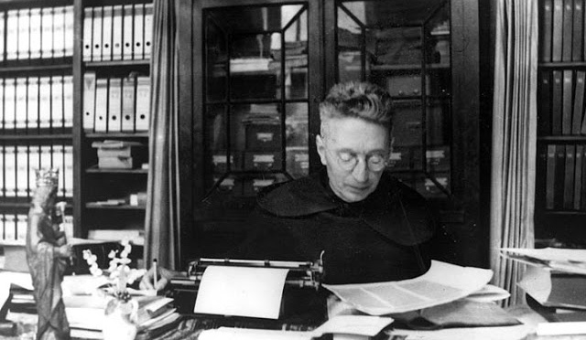
PROFESSOR - RECTOR MAGNIFICUS
One of the founders of the Catholic University of Nijmegen (now Radboud University), Brandsma became a professor of philosophy and the history of mysticism at the school in 1923. He later served as Rector Magnificus. He was noted for his constant availability to everyone, rather than for his scholarly work as a professor.

Slide 13
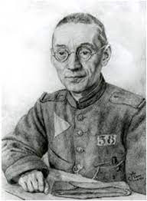

Slide 14
Encountering God in Life's Journey
Living in the Presence of God
Mystery of God’s nearness
Open your eyes and see all that is!
To believe in God is the same as to live in God

Slide 15
Mysticism Introduction
Mysticism is a way for “it all” to be always “present” – for God to be immediately and palpably near
We don’t simply decide, of course, that we will become mystics.
God becomes flesh as we become more human!!!!!

Slide 16
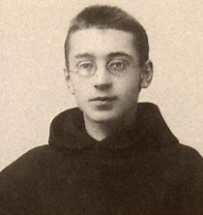
Cell in Silentiuum perpetuum
From the very beginning his cell had a special meaning for him. No disturbing sounds could penetrate this place.
Even the silence becomes even more intimate.
On the wall of the hallway where his cell is located Titus saw a sign which, in plain letters, read: “Silentium perpetuum” (perpetual silence). 18

Slide 17
Silence…
For Titus this little notice about Silencio meant that silence is a process that will initiate him ever more deeply into a religious reality and that this process is never ending

Slide 18
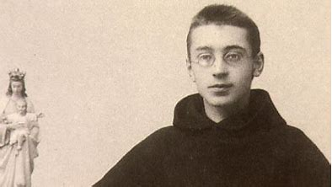
The “NOW”
This is the place where he is at home - where he always finds rest.
In Nijmegan people said of him that he was really “somebody”. Now he is really “somewhere”.

Slide 19
What ever he may be doing, he will stop and do what the rule of the monastery requires. He must learn to live in the “now”. He knows that much can happen if he totally concentrates on the ”now”.

Slide 20
Cell – God’s nearness
His cell which he describes in detail can be understood as the key phrase for Titus’s experience of God’s nearness.
In the final phase of his life it returns in a poem which became widely known in the postwar years. His cell is his mighty fortress, several living wellspring of life. There he became familiar with God’s nearness. 19

Slide 21
For Titus, the cell is the symbol of a deeper reality –where he nurtures this interior life of faith
The cell is the place where he where he grows most profoundly in interior freedom.
This is the place where the interiorization of the cell happens – a place where he is most deeply and intimately connected to God, where the interior prayer of the heart finds is expression.
This is where is he more himself.

Slide 22
In his cell - interiorization
In times of difficulty, sometimes referred to as the dark side of his life, Titus immersed himself in his studies and turned his gaze inward: he was “in his cell.”
After such a period of rest he would, with new warmth and receptivity, again turn outward.
Process of interiorization.
These periods recurred in his life
to the very end.

Slide 23
Importance of mysticism for Titus
The study of mystical writers in the tradition became one of the central themes of his scholarly pursuits very early.
He believed that the mystical life is not beyond the reach of ordinary people. He made this a central aspect of what he taught too many people at the University and beyond.
His study of mysticism was “a kind of dialogue with the past, a creative encounter with a rich experience. The central idea being that God is inexpressively near to us in this world”.

Slide 24
Mysticism… the Mystery of God’s nearness”
In our daily life, with its challenges and struggles mysticism might seem to be far away, or irrelevant but from Titus Brandsma we can learn that mysticism is closely connected to the ordinary life of ordinary people as “the Mystery of God’s nearness.”
“…the Mystery of God’s nearness” - the holy ground of our every day.

Slide 25
Everyday Mysticism… “there is more!”
During one of his lectures on the image of God at the Catholic University of Nijmegen, Titus says that we must look for the secret of our origin “first of all in ourselves. God is there and reveals himself to us there. He wants to be seen and recognized there. He is, after all, nowhere more clearly noble to us than in the ground of our being…”
Titus Brandsma says: “Open your eyes and see all that is”. Do not just see shadows. Do not just see what life appears to be: there is more!”

Slide 26
Mysticism…God lives and works in us
“We look for miracles, to praise God’s love and goodness, his power and glory in them, but we forget, that our life of grace is a treasure and a privilege, for which we can never laud and praise Him enough. Although the union with God as well as the divine work are hidden behind that which is human, we know with the utmost degree of certainty that God lives and works in us.” 3

Slide 27
Mysticism… the grace of our lives
We search for the special, the miraculous, the extra-ordinary, but we forget to appreciate the grace of our lives itself.
When Titus speaks about our special privilege as human beings, he refers to the grace that God wants to unify Himself with us even more than with the rest of Creation as we learn from the incarnation of God in Christ: in the same way God wants to incarnate in us.

Slide 28
Mystery of God’s Nearness
It characterizes him because he was thoroughly convinced that the mystical life belongs to ordinary people. Therefore, he consistently made every effort to ensure that the mystical tradition would become a living part of the widest possible segments of the culture.
It is part of his image of God: God’s presence in the core of everybody – without exception, no-one excluded. God gives witness to himself in all creation exactly in the place where you are.

Slide 29
Mystery of God’s Nearness… the deepest ground of our being
“He is the deepest ground of our being, concealed in the innermost part of our nature, but there nevertheless to be seen and contemplated." 5
And not only in ourselves, in every human being, and in all creation! “He is knocking, waiting for us to open the door

Slide 30
Mysticism… God’s abundant love
Titus speaks about ‘a grace so overwhelming that the capacity of the soul, and often almost all its work, is dominated by it.’ John of the Cross calls this the state of Gods abundant love,
Titus calls it: God’s overwhelming love.
And refers to it as ‘the beauty of mysticism’.

Slide 31
Mysticism 8 (Our Lady of Mt Carmel)
Titus Brandsma refers to Our Lady of Mount Carmel, Mother Mary, as our splendid example; as the most pure human being that showed how God lived and worked in her.
Most Pure Heart of Mary
“God lives in us. He is hidden in our human nature. But our nature is – in His hands – suitable for higher and more sublime work than the sensory knowledge or the contemplation of our mind can bring about. It has a receptivity that makes it fit for absorbing divine action even more than by the usual way of nature in such a way, that the divine is no longer hidden behind the human, but shines through it”

Slide 32
“Other Mary’s
Titus Brandsma said that all Christians and especially Carmelites should be “other Marys” in the sense that just a Christ grew in her and came to birth, so must we allow the love of God to grow in us. Just as she was the “God-bearer” for the world, we too must bring God into every situation and be able to perceive the presence of God that is so often hidden by external realities. He also said that Carmelites are to prolong in the Church what God had worked in Mary.

Slide 36
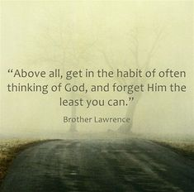
Brother Lawrence of the Resurrection Practice of the presence of God

Slide 37
Advice from Br. Lawrence on How to Practice the Presence of God
So how do we cultivate this habit?
Lawrence says (M 29): “We must take special care that this inner awareness, no matter how brief it may be, precedes our activities, that it accompanies them from time to time, and that we complete all of them in the same way.”

