Slide 1
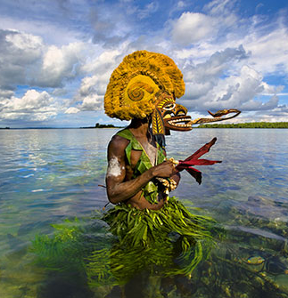
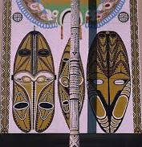
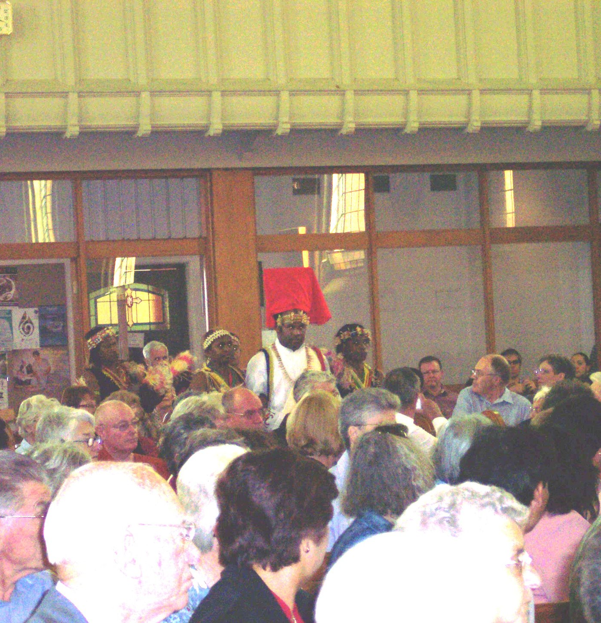
Melanesian Indigenous Spirituality with mine
PRAYER Shark catching ritual;
SYMBOLS Traditional totem
ACTION Inculturation

Slide 3
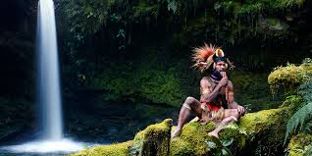
Who we are?
What is Melanesian? Who are Melanesians?
Spirituality
Relational Stories

Slide 4
Introduction

Slide 5
My Story as Melanesian Carmelite in a Melanesian Way

Slide 6
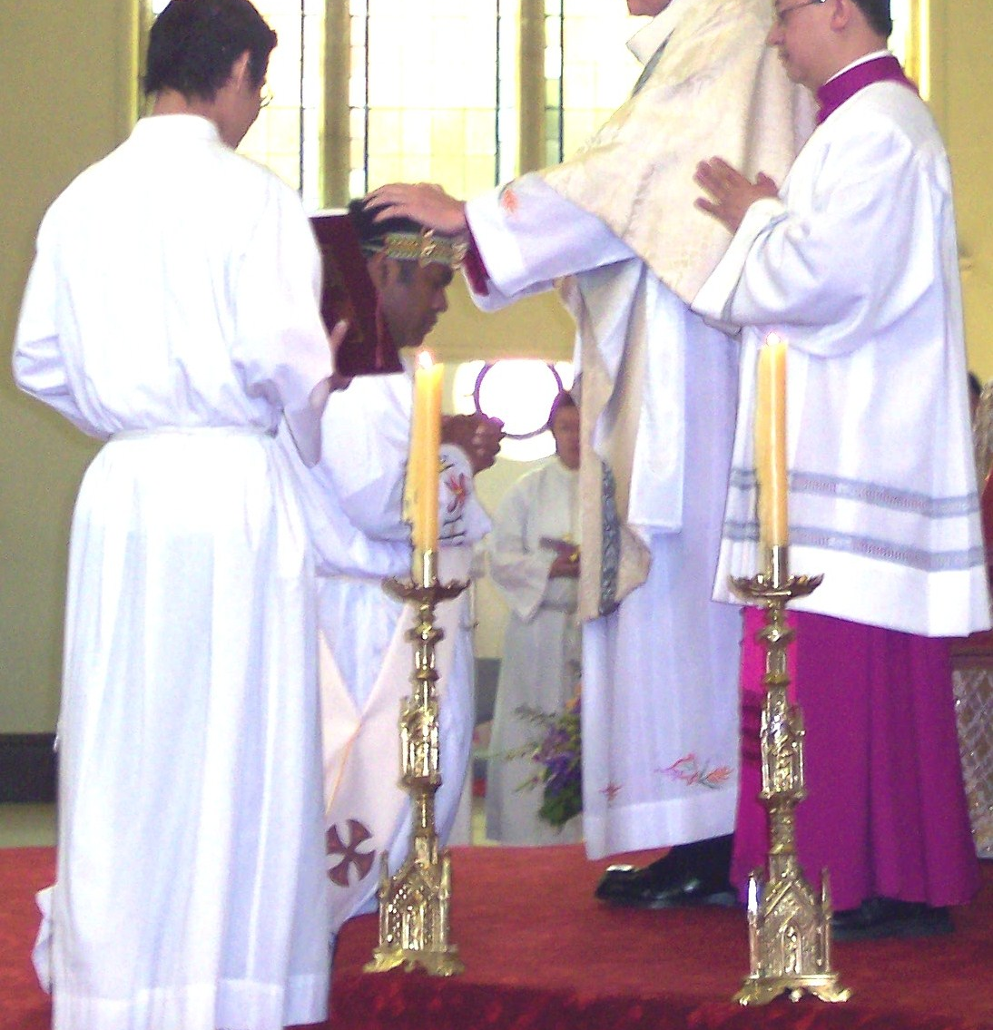
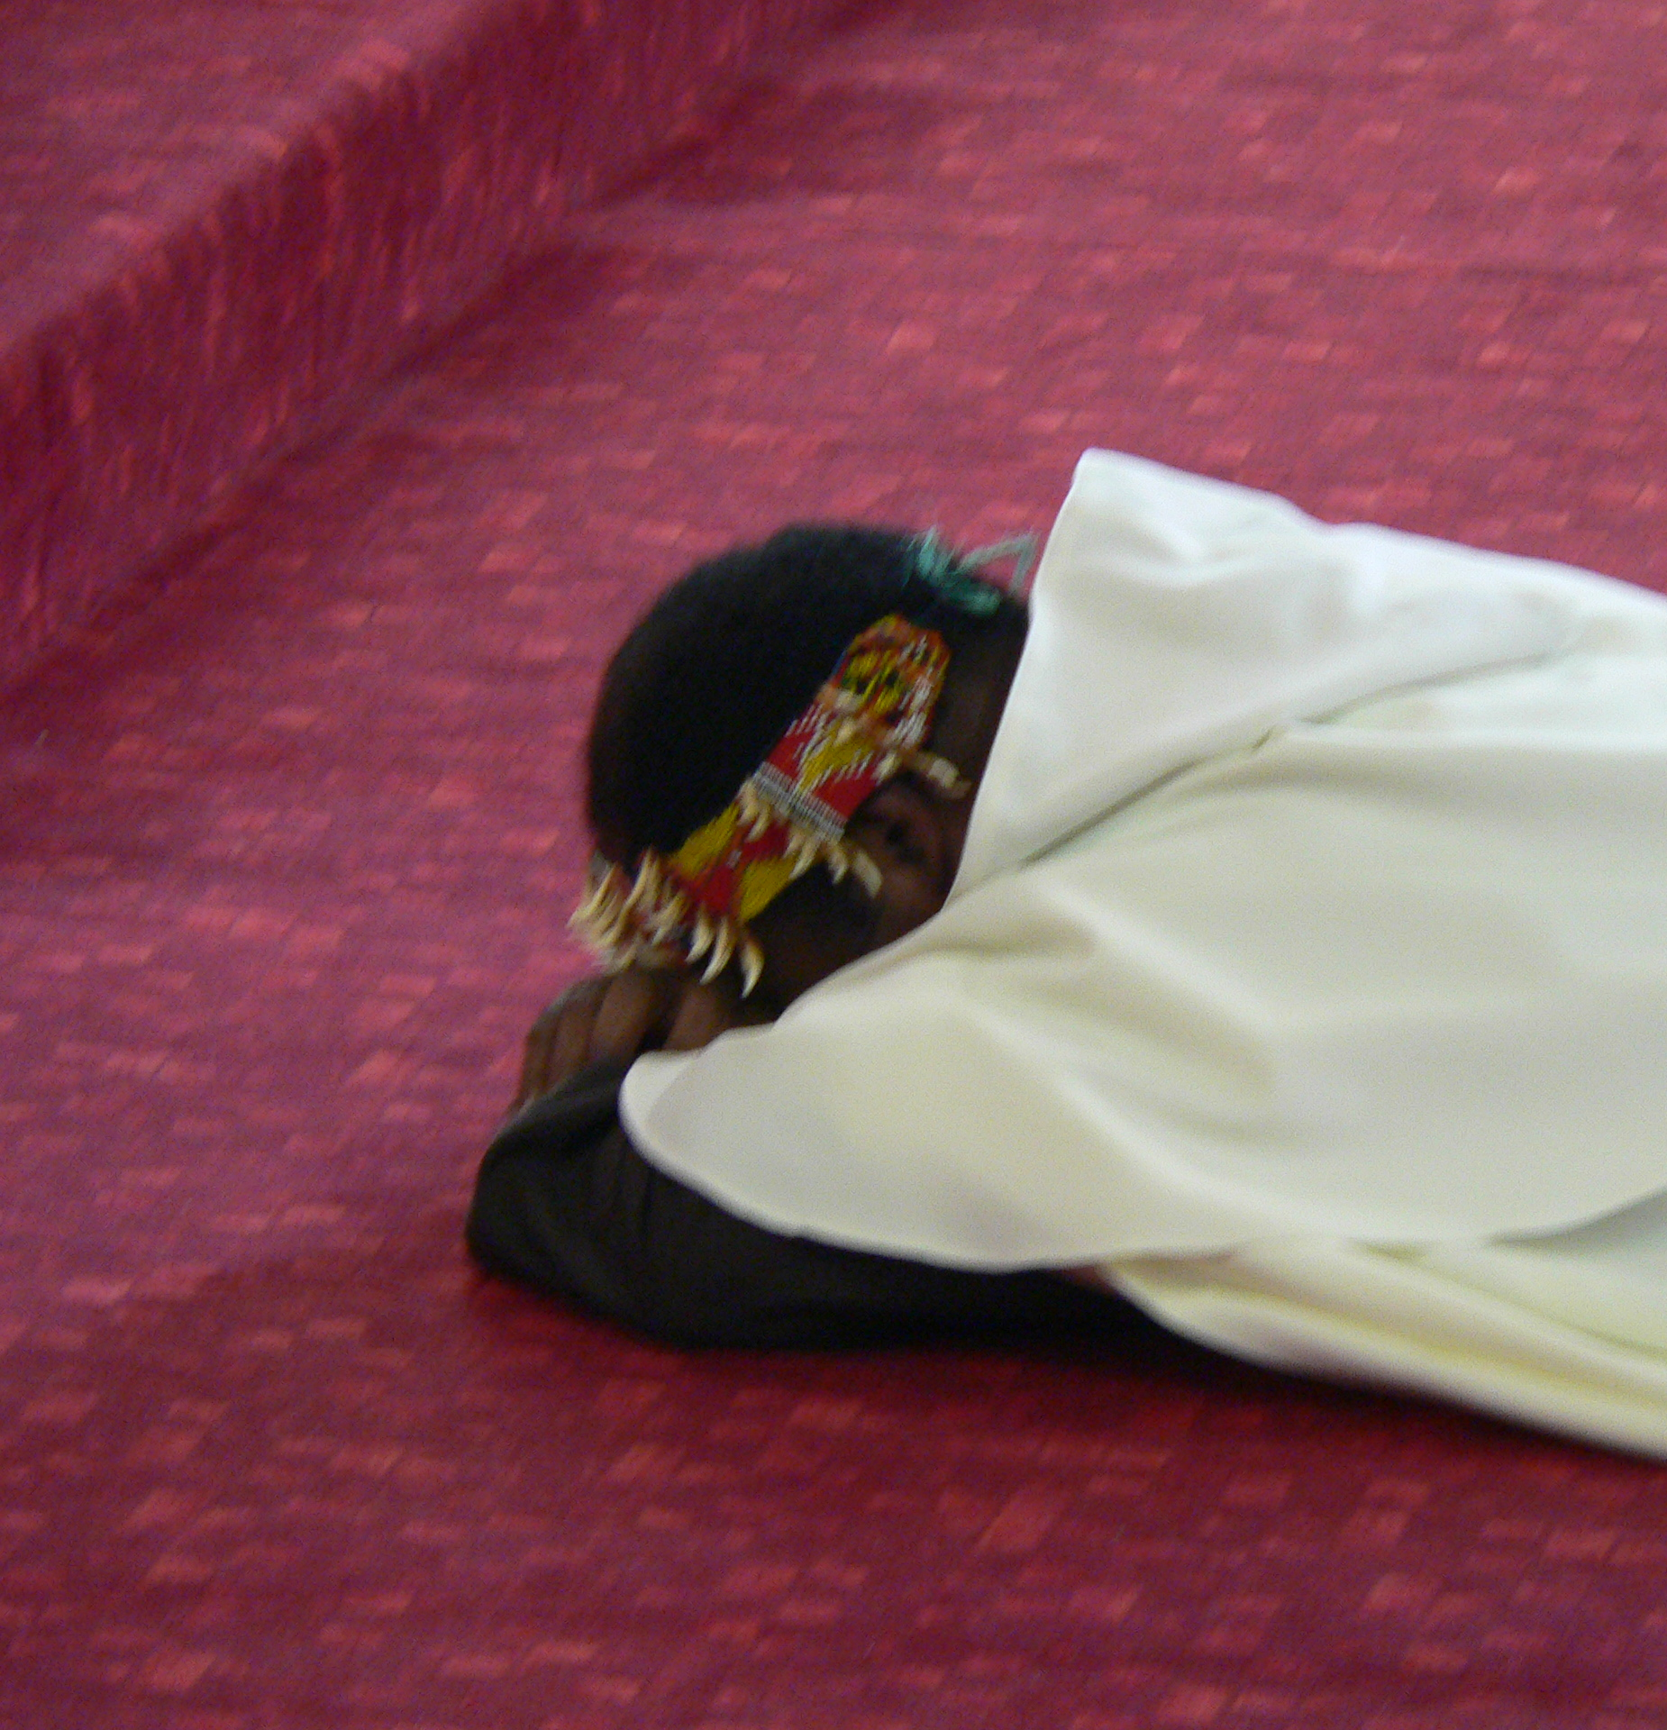
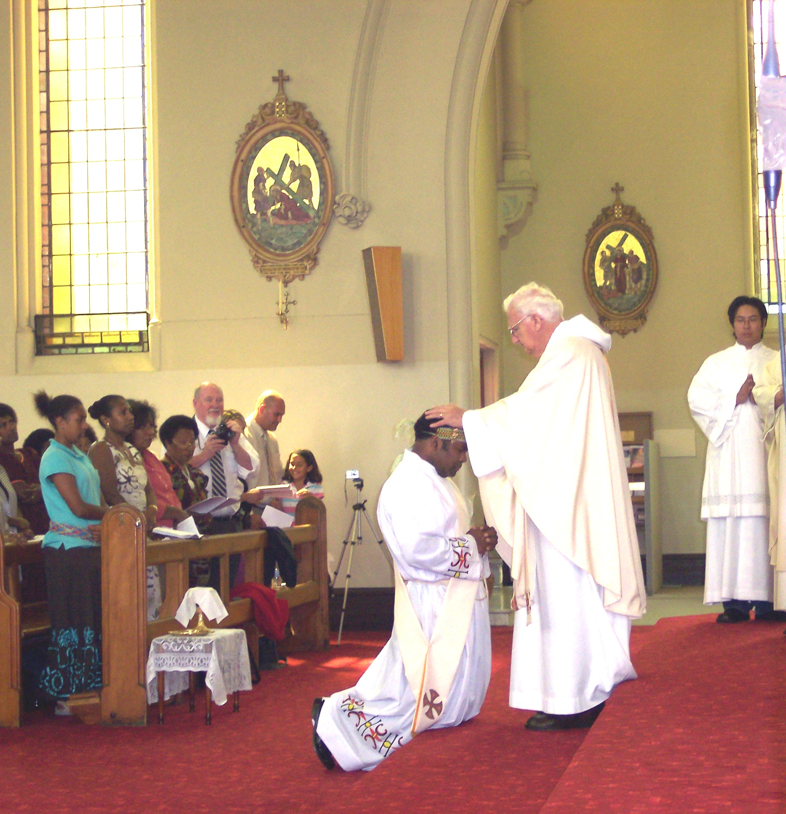
6

Slide 7
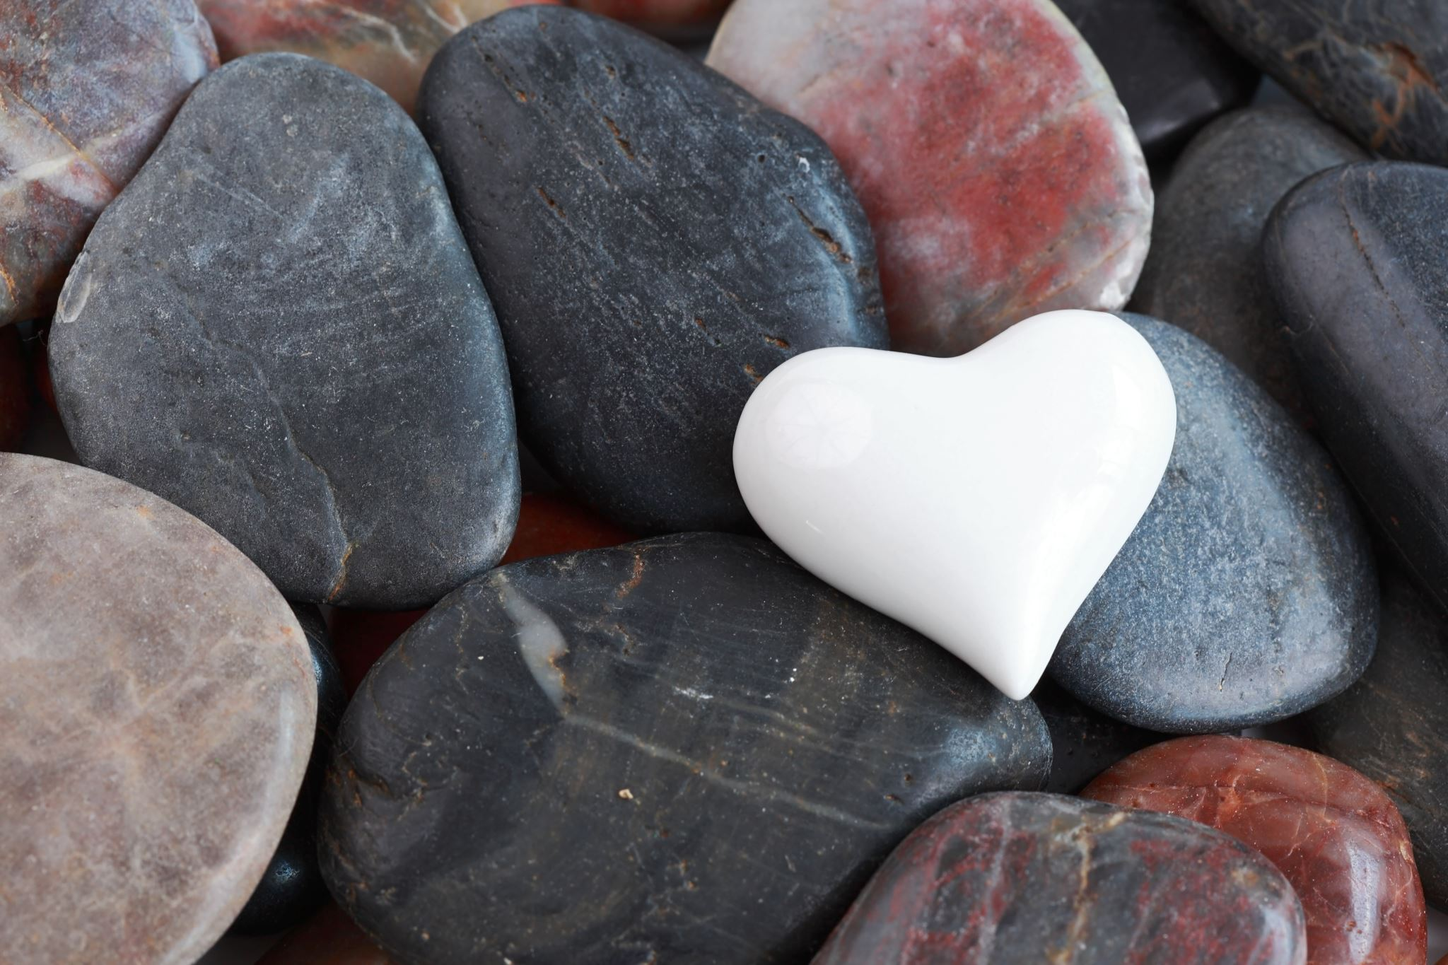
“Like the Carmelites we learned to tell the story of the human heart as a love story that we are relational."- We call, The Carmelite Way
What we call "Carmel" is really a way of life in which we try to be aware of the Presence of God in the most ordinary, everyday things. Melanesians have the similar way of life then. We're contemplative, but we live out our service in the world as a clan or community. We're prayerful in our ritual, but we're also practical in our actions. The Carmelites were founded over 800 years ago on a mountaintop, but we have our feet firmly planted in today's problems and concerns. As Melanesians we have emerged from 1000s of years ago and continue telling our stories and following the footsteps of our ancestors and firmly rooted in our indigenous culture.

Slide 8
Australian Aboriginal
In fact, going by the tripartite typing of Pacific identity along with Micronesians and Polynesians, Australian Aboriginals/First Nations are actually Melanesians. The distinction was coined in the 1830s by the French explorer and polymath Jules Dumont D'Urville, who divided the Pacific into three regions.

Slide 9
Key elements- Spirituality
To BE
Melanesian spirituality holds that people are part of the cosmos and that their world is integrated. People suffer because of broken relationships with the cosmos; misfortune is also seen as the punishment for any broken relationship
The drive for an abundance of life here on earth is a major concern for Melanesians and is a sign of great blessing. Traditional Melanesian spirituality is viewed as a people’s expression of their totality relationship to the great spirits of the land, forest, mountains, rivers, birds and animals. In brief, Religion is a way ‘To Be.

Slide 10
Spirituality
Religion in Papua New Guinea is dominated by various branches of Christianity, with traditional animism and ancestor worship often occurring less openly as another layer underneath or more openly side by side with Christianity.

Slide 11
To Be -ENCOUNTER
Some see baptism, confirmation, and communion as elements of a unified sacrament through which one becomes a Christian and part of the church.
Melanesians see it as our ENCOUNTER of relationship as birth, initiation into the clan, marriage and death unify under a concept of integrated worldview, community, relationships and rituals.
Those who are drawn by the Carmelite tradition are often pilgrims to places unknown, trusting the testimony of others who have taken the same ancient path. became hermits, living where Jesus lived, knights in service of their liege Lord. They pledged to live in allegiance to Jesus Christ.
Melanesians are nomads who found places now they call home.

Slide 12
Cosmic Spiritual
Animism (from Latin: anima meaning 'breath, spirit, life') is the belief that objects, places, and creatures all possess a distinct spiritual essence. Our spirituality derived from that aspect of animism.
Animism perceives all things—animals, plants, rocks, rivers, weather systems, human handiwork, and in some cases words—as being animated, having agency and free will.

Slide 13
To go deeper, in Melanesia the animae are the souls of living men, the ghosts of deceased men, and spirits "of ghost-like appearance" or imitating living people. Spirits can inhabit other objects, such as animals or stones.

Slide 14
Creation (Environment)
Care for God's Creation. God created the world and entrusted it to us as a gift. Now we have the responsibility to care for and protect it and all people, who are part of creation. Protecting human dignity is strongly linked to care for creation.

Slide 15
Spirit of the Land
God’s spirit in creation Story - Genesis
Breathing – wind, breath,
Spirit of the sea and land, night and day
Melanesians, however, believe that the world has always existed, so they have few stories about creation. Yet various figures do play roles in changing parts of the world and in the formation of islands and features of the landscape.

Slide 16
Experiences
Melanesian spirituality has emerged from the experience of its people. This is clearly reflected in the lives of the people where there is no dichotomy in how they treat sacred or profane, religious or non-religious. There is integration between the sacred and the secular for the Melanesian who holds everything as integral.

Slide 17
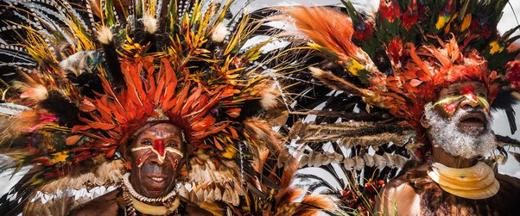
Conclusion

Slide 18
Community - Carmelite
Community is a key element and value in Melanesian culture and everything is done for the well-being and joy of the community. The community is there to support and care for the value of life. Often individual interests and needs are ignored because community needs take precedence. The traditional Melanesian code of ethics is community based: ‘What helps the community is ethically good, what harms the community is ethically bad and what is indifferent to the community is indifferent’. This concept would give some insight to the frequent tribal war that occur in different areas of Papua New Guinea.
Community members are there to protect and avenge any wrongdoing against clan/tribe members. For example, in the highlands of PNG fighting and killing the enemy of a warring clan/tribe were believed to be sound and acceptable practice as a payback. If retaliation did not happen for a killing in the clan/tribe, this would be considered ethically wrong, a sign of being a traitor to one’s own clan/tribe.

Slide 19
Thank you
Paul Sireh O.Carm

